Slide 1
“Prediction of residential building energy consumption: A neural network approach”
Energy AI Track Kim Sohee

Slide 2
Contents
1. Introduction
2. Background on application of neural network models
3. Modeling approach
4. Experimental environment: TxAIRE research house
5. Results and discussion
6. Concluding remarks

Slide 3

01. Introduction
Residential dwellings sector “is largely an undefined energy sink” when compared to the commercial, industrial, and transportation sectors
Contributing factors = Size, location of the living space
Small flats or apartments require less energy compared to big houses
Others that hinder energy consumption studies
Variations in building characteristics (size and number of windows)
Different types of occupant behavior (how often, long used)
Privacy issues for collecting and sharing data (occupants’ income)
High costs of sub-metering energy usage (space heating, cooling)
Notes:
Residential dwellings account for a considerable portion of the growing energy demand in the world today, yet this sector “is largely an undefined energy sink” when compared to the commercial, industrial, and transportation sectors

Slide 4
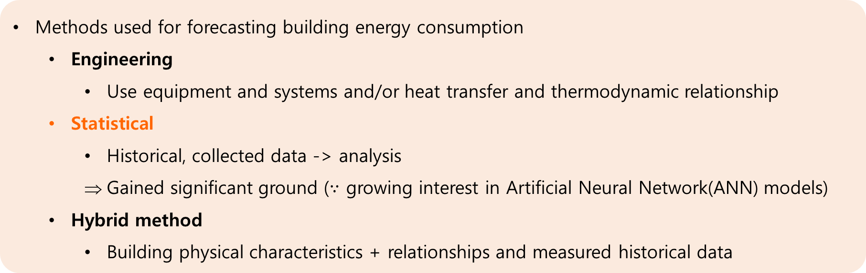
01. Introduction
Residential sector consumes transformed energy (secondary energy)
Modeling and simulation is significant in
Analysis of alternative designs of new buildings
Retrofits, to evaluate and decide on the most efficient, cost-effective selections
Methods used for forecasting building energy consumption
Engineering
Use equipment and systems and/or heat transfer and thermodynamic relationship
Statistical
Historical, collected data -> analysis
Gained significant ground ($∵$ growing interest in Artificial Neural Network(ANN) models)
Hybrid method
Building physical characteristics + relationships and measured historical data

Slide 5
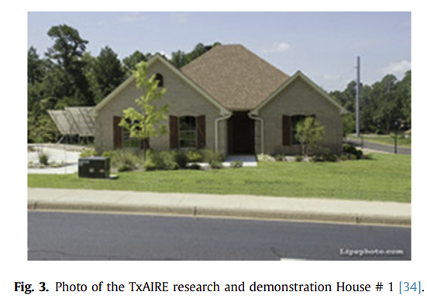
01. Introduction
Artificial Neural Network
Ability to perform nonlinear analysis
To do parallel structures that allow uninterrupted computing
To learn and train
implement with flexibility and relative ease
Effective approach in building energy applications (than the conventional statistical models)
In this study,
Used data for an unoccupied research house
Variation in energy consumption is strongly dependent on weather
From other studies
without influence of weather conditions, the energy use would be similar
The monthly energy consumption changes due to weather

Slide 6
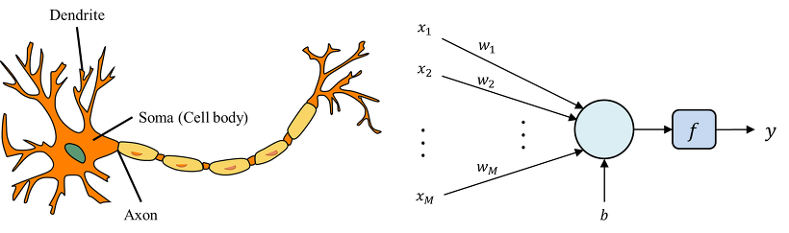
02. Background on application of neural network models
Artificial Neural Network
Developed to generalize the nervous system of a human being → mathematical models
Concept of NN analysis become wider and popular in the past 2 decades
Modeling of energy consumption in individual buildings
Ability to handle nonlinear patterns with high computing speed and high accuracy
more reliable at predicting energy system than traditional statistical approaches

Slide 7
02. Background on application of neural network models
Building energy consumption
High accuracy is important
Underestimation of energy consumption could lead to potential outages that can be detrimental to social and economic lifestyles
Overestimation would lead to unnecessary idle capacity and thus wasted financial resources
Several studies,
Comparison of methods, used to model residential energy consumption at the national level
NN method resulted in very high prediction performance - coefficients of determination of 0.87↑
significantly better than prediction performance of Engineering method (EM)
NN approach can be applied to individual homes. => compared other modeling approaches
NN models have distinct advantages in predicting the energy consumption and the impact of socio-economic factors on energy consumption.
Notes:
과소평가는 사회 및 경제 lifestyle에 해로울 수 있는 잠재적 outages로 이어질 수 있고, 과대평가는 불필요한 idle 용량과 재정자원 낭비로 이어질 수 있기 때문에 높은 정확도는 에너지 소비 모델의 개발에 중요하다.
Building energy consumption is a vital variable.
Thus, high accuracy is important in development of the energy consumption model because underestimation of energy consumption could lead to potential outages that can be detrimental to social and economic lifestyles while overestimation would lead to unnecessary idle capacity and thus wasted financial resources
There are several studies about NN methods.
A study carried out a comparison of methods that are currently used to model residential energy consumption at the national level. => NN method resulted in very high prediction performance
with the coefficients of determination of 0.87 and higher, which is significantly ~~
NN approach is not just limited to national residential building energy forecasting, but also can be applied to individual homes.
One of those studies developed an ANN model to compare with other modeling approaches.
It indicated that NN models have distinct advantages in predicting the energy consumption and the impact of socio-economic factors on energy consumption.

Slide 8
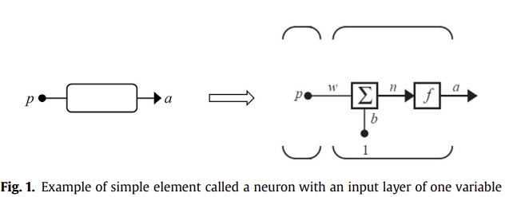


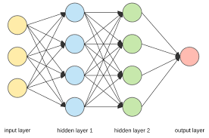
03. Modeling approach
ANN model
Neuron n
Input p
Weight function w
Bias function b
Activation function f()
Input layer : all input variables
Hidden layer (one or more)
Output layer (one or more outputs)
Number of neurons can vary for each layer independently.
Notes:
ANN model consist of simple individual element (neurons)
Each Neuron n has an input p, a weight function w and a bias function b
where f( ) is an activation function to scale or convert the neuron value into meaningful response values for further analysis. It can be a linear function, or the log sigmoid function.
A typical network consists of an input layer, one or more hidden layers where each layer has more than one neuron operating in parallel, and an output layer of one or more outputs that can be represented by the neurons
Number of neurons can vary for each layer independently.
The input layer consists of all input variables.

Slide 9
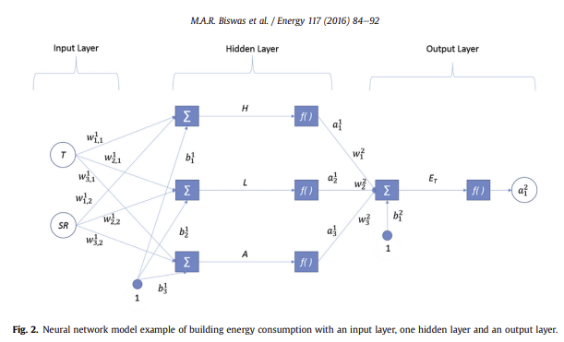

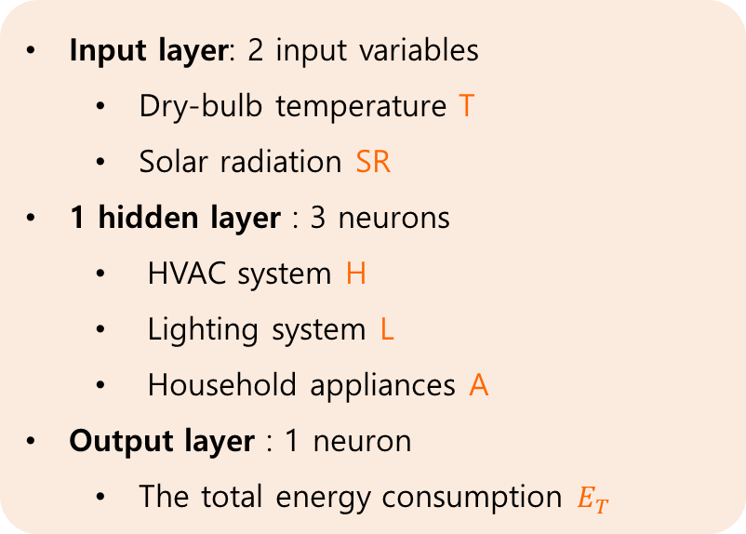
03. Modeling approach
Input layer: 2 input variables
Dry-bulb temperature T
Solar radiation SR
1 hidden layer : 3 neurons
HVAC system H
Lighting system L
Household appliances A
Output layer : 1 neuron
The total energy consumption $E_{T}$
output of layer = input of next layer
Each neuron is connected to all other neurons of the previous layer through a weight functions w
Response => generated by the activation function f()
Notes:
The neurons in subsequent layers receive a neuron response of the previous layer as their inputs. Each individual neuron is connected to all other neurons of the previous layer through a weight functions w and its response is generated by the activation function f( ).

Slide 10
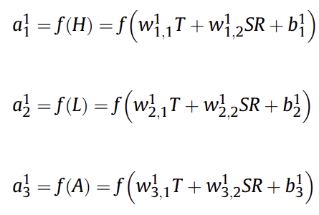



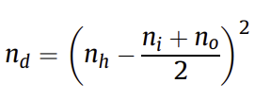
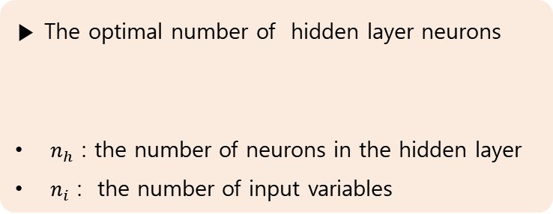
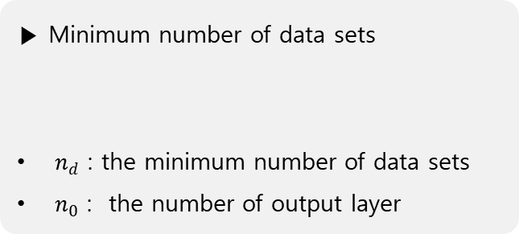
03. Modeling approach
Hidden layer
Activation function
Output
▶ The optimal number of hidden layer neurons
$n_{h}$ : the number of neurons in the hidden layer
$n_{i}$ : the number of input variables
▶ Dataset
Training
Validation
Testing
▶ Minimum number of data sets
$n_{d}$ : the minimum number of data sets
$n_{0}$ : the number of output layer
Notes:
The summation and activation in the hidden layer would be ~~
subscripts are element indices of the parameters (weight and bias), 1, 2, 3
and superscripts are the layer indices of the hidden layer. There is 1 hidden layer so it would be 1.
And activation function is also the linear function, so output response is like this, which leaves the output neuron to this.
However, the best model depends on the number of hidden layer neurons to enhance the results so an optimum number of hidden layer neurons would be based on a desired model accuracy. So the optimal number of hidden layer neurons could be established using a formula. ni is the number of input variables.
After the layer and neurons of the NN model are determined, a collected dataset is randomized and divided into 3 sets, training, validation and testing.
By this minimum number of datasets can be calculated. no is the number of neurons in output layer.
NN train weight and bias parameter with training set until all the errors are within the required tolerance. Then the validation set determine if the model is adequate.

Slide 11


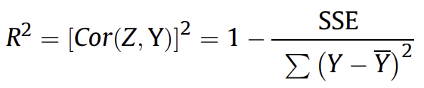
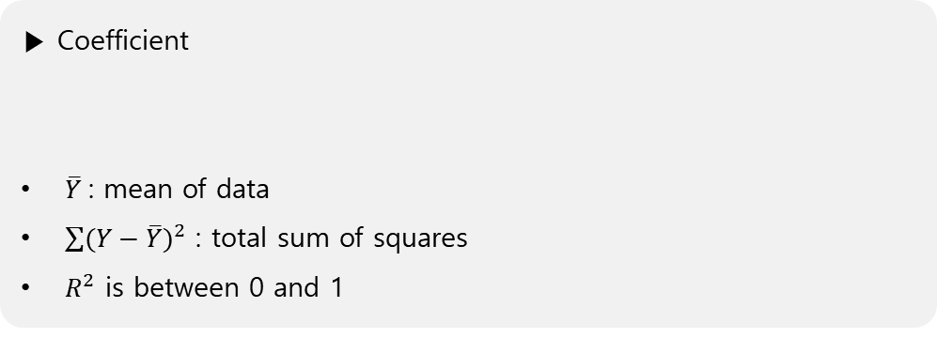
03. Modeling approach
▶ Minimizing the error value
Target (actual data values) ↔ predicted data values
Sum of squares error (SSE) :
Z = set of predicted values
Mean squared error (MSE) :
n = number of data points in the set
▶ Coefficient
$\overline{Y}$ : mean of data
$\sum{{(Y−\overline{Y})}^{2}}$ : total sum of squares
$R^{2}$ is between 0 and 1
Notes:
The model is achieved by minimizing the error values between the target or actual data values and the predicted data values based on the pattern given.
Different type of error minimized in the model ~~
These errors can then be used in different statistical analysis including the coefficient of determination.
This coefficient can be described as this, ~~
a value of R^2 is between 0 and 1. When it is 0.9, it indicates that 90% of the total variability in the response variable is accounted for by the predictor variables

Slide 12

03. Modeling approach
▶ Minimizing the error value
Target (actual data values) ↔ predicted data values
Sum of squares error (SSE) :
Z = set of predicted values
Mean squared error (MSE) :
n = number of data points in the set
▶ Coefficient
$\overline{Y}$ : mean of data
$\sum{{(Y−\overline{Y})}^{2}}$ : total sum of squares
$R^{2}$ is between 0 and 1
Notes:
The model is achieved by minimizing the error values between the target or actual data values and the predicted data values based on the pattern given.
Different type of error minimized in the model ~~
These errors can then be used in different statistical analysis including the coefficient of determination.
This coefficient can be described as this, ~~
a value of R^2 is between 0 and 1. When it is 0.9, it indicates that 90% of the total variability in the response variable is accounted for by the predictor variables

